Slide 1

CROP PRODUCTION ANALYSIS IN INDIA

Slide 2
Business Problem
The business problem described in the text revolves around the need for effective and flexible collaboration among numerous stakeholders in the agri-food sector. As the agriculture business domain evolves due to advancements in the Future Internet, there is a growing need for a Business-to-Business (B2B) collaboration platform that can facilitate this collaboration.

Slide 3
Details of Data
State Name : This column defines the name of state where the data of crop production is collected.
District Name : It shows the name of the district within the state where data is collected.
Crop Year : This Column defines in which year the crop is harvested.
Season : Season in which crop was grown and gives the production
Crop : Which type of crop is harvested for production
Area : Area of land used for cultivating the crop
Production : Amount of production does the crop produced.

Slide 4
Insights
Kerala is the top production state followed by Andhra Pradesh and then Tamil nadu.
Cereal , Pulses, Oilseeds are the top three most produced crop categories.
The dataset contains 6 types of season and top 3 season are Kharif , Rabi and the Whole year.

Slide 5
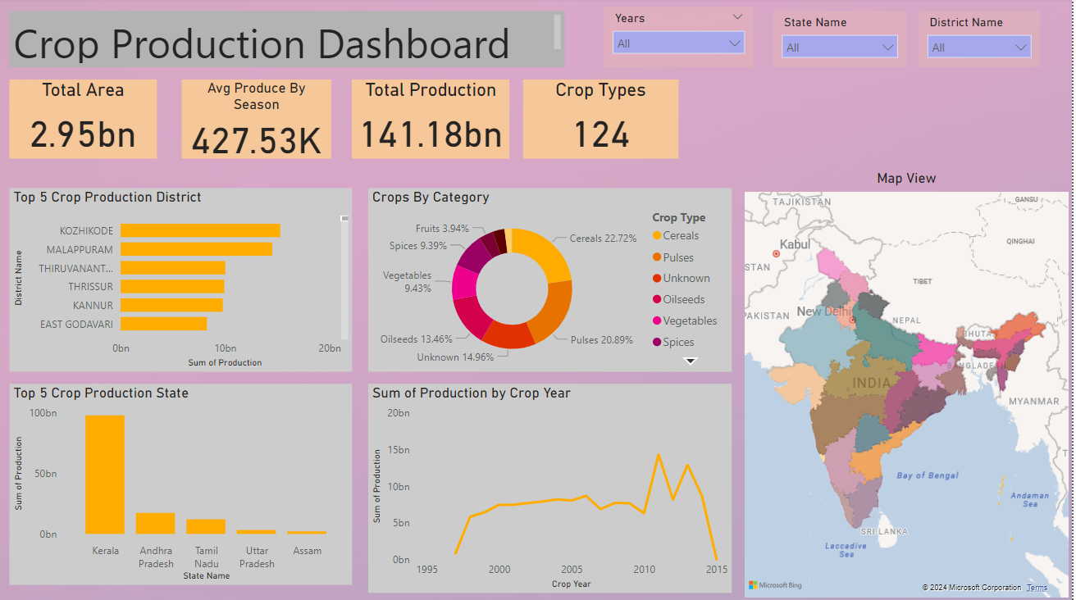
My Dashboard

Slide 6
THANK YOU

